Slide 1






TERTIARY
BACHELORS
DEGREES
NTO
Nurturing Talent and Opportunities

Slide 2


Features
What is a
Tertiary Bachelors Degree?
Guaranteed and seamless transition
A tertiary degree is one that commences in an Education and Training Board (ETB) and continues in a Higher Education Institution (HEI), culminating in the award of a degree that supports strategic and inter-disciplinary collaboration and specialisms that meet local/regional skills need.
Co-developed by ETB and HEI with input from Regulatory body and NTO
Same quality of learning and pedagogy
Entry requirements are not based on points system
Embedded Awards
Learner financial, academic and wellbeing supports

Slide 3





Tertiary Degrees 2026
BA (Hons) Immersive Media Production
BA (Hons) in Animation, Visual Effect and Motion Design
BA (Hons) Politics, Society and Media
BSc (Hons) Digital Arts
BSc (Hons) in Information Technology Management
BSc (Hons) in Mobile & Web Computing
BSc (Hons) in Software Development
BSc in Process Manufacturing Practice & Technology
IT & Technology
Art and Media
BA (Hons) Social Care Practice
BSc (Hons) in General Nursing
BSc (Hons) in Intellectual Disability Nursing
BSc (Hons) in Mental Health Nursing
BSc (Hons) in Public Health and Health Promotion
BSc in Applied Health Care
Bachelor (Hons) of Social Work
BSc (Hons) in Occupational Therapy
BBs (Hons) Business and Psychology
BA (Hons) in Digital and Business Skills
BBs in Tourism and Hospitality Services
Bachelor (Hons) in Business
BSc (Hons) Applied Sports Science
Health
Other
*Availability of all courses is subject to approval and validation
Entry is not based on points, and no college fees for the first 1 - 2 years while studying in ETB. Students graduate with the same recognised full degree as their peers who followed the traditional route. List of tertiary degree programmes and general information can be found on NTO.ie website.
Apply at NTO.ie

Slide 4
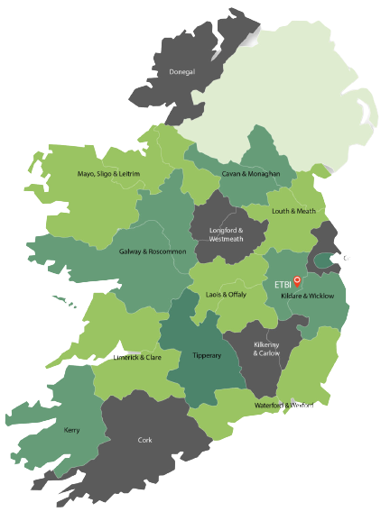
Tertiary Degrees 2026
Trinity
IADT
ATU
TUD
TUS
UCC
MTU
SETU
DKIT
NCI
MIC
UCD
16
12
ETBs
HEIs
Contacts:
eMail: info@nto.ie
Website: www.NTO.ie
LinkedIn: https://www.linkedin.com/in/ntoireland/
Facebook: National Tertiary Office
Instagram: ntoireland

