Slide 1




TRANSFORMING TERTIARY EDUCATION
NTO
Nurturing Talent and Opportunitites

Slide 2

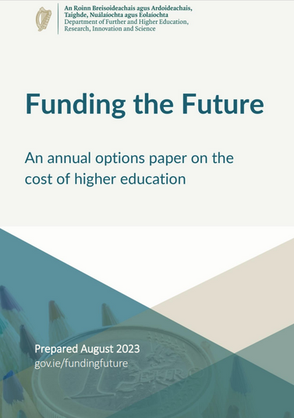

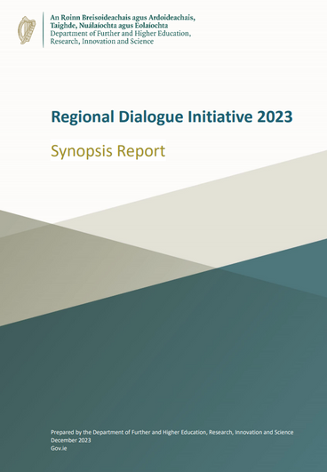



Policy
Context

Slide 3

National Tertiary Office
The NTO facilitates thematic engagement between Education and Training Boards (ETB) and Higher Education Institutions (HEI) to underpin the development process of tertiary degrees.
The tertiary degree pathway is developed by ETB FET colleges and HEIs, working in partnership with the NTO and profession regulator/s.
The final Bachelor or Bachelor (Hons) awards are awarded by the HEI.

Slide 4



Key Drivers & Priorities
Progressing a More Unified Tertiary System for Learning, Skills and Knowledge.
Inclusive education promoting widening of access and diversification of learners.
Focusing on acknowledging the applicant’s full talent and potential looking beyond the points and grades.
Promoting flexibility and lifelong learning pathways.

Slide 5



WHAT is a Tertiary Degree?
A tertiary degree is one that commences in an Education and Training Board (ETB) and continues in a Higher Education Institution (HEI), culminating in the award of a degree that supports strategic and inter-disciplinary collaboration and specialisms that meet local/regional skills need.
Courses agreed by NTO for inclusion will support the diversification of professions, have a geographical need and meet a recognised skill need for that area.

Slide 6

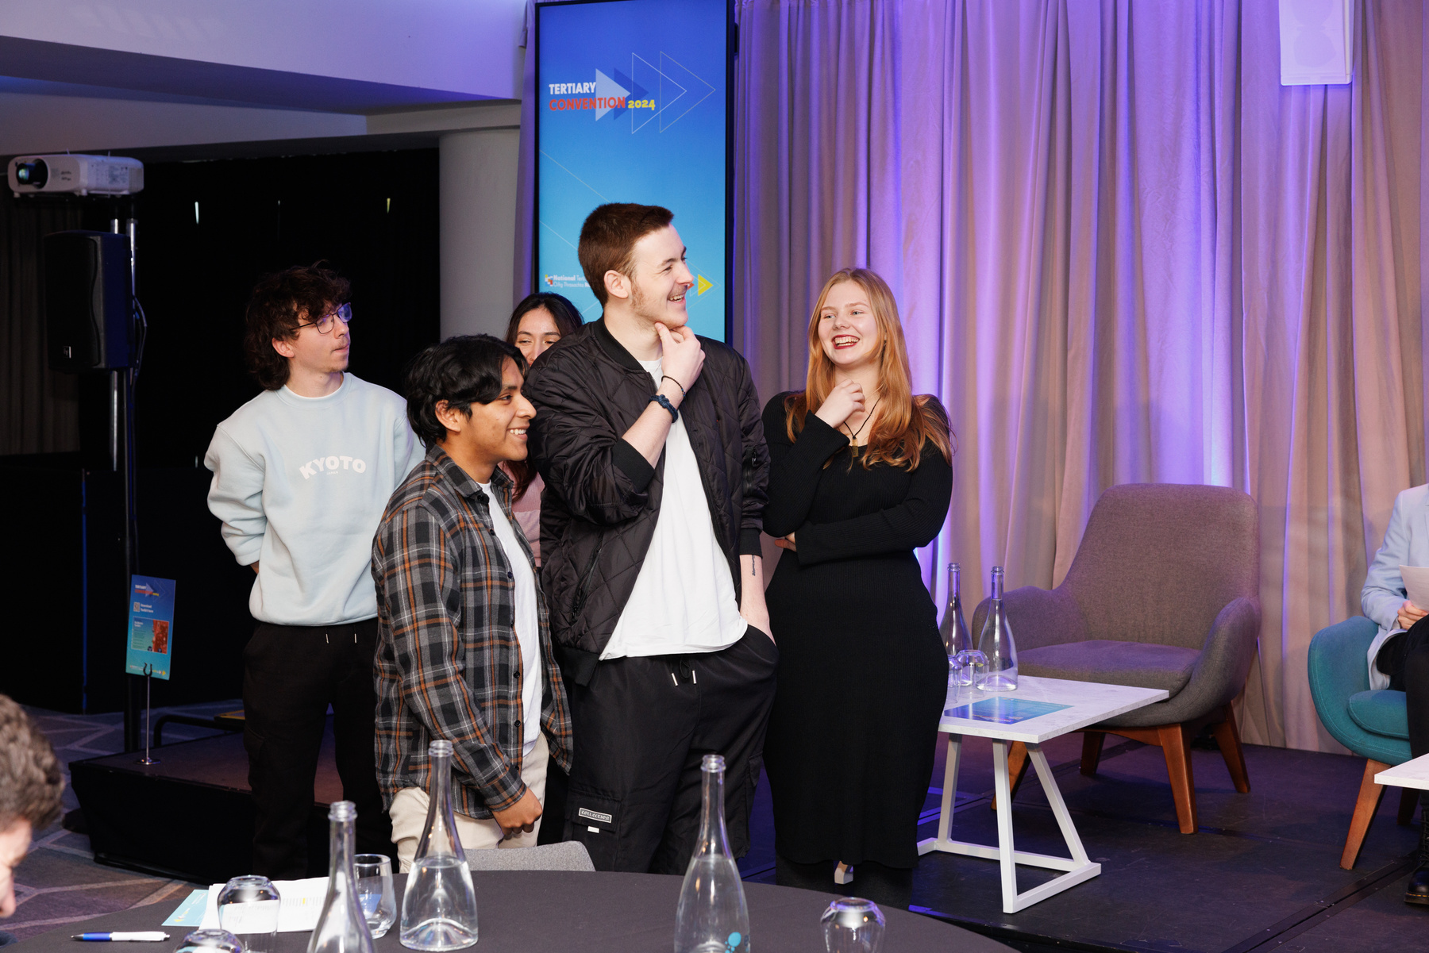
Tertiary Degree
Features
Guaranteed and seamless transition
Co-developed by ETB and HEI with input from Regulatory body and NTO
Same quality of learning and pedagogy
Entry requirements are not based on points system
Embedded Awards
Learner financial, academic and wellbeing supports

Slide 7

Tertiary Degree Model
1
2
3
1
Bachelors
NFQ Level 7
Degree
or
Bachelors
Honours
NFQ Level 8
Degree
ETB
NF embedded Award NFQ Level 5
+
+
+
+
NTO
Regulatory Body
HEI
3
2
1
4
Embedded Award NFQ Level 6
Integration of theory and practice through further education, university and placement-based learning.
Competencies and learning outcomes alined to ensure that proficiencies required by a regulator are achieved.
Same quality and vocational pedagogy
Same quality of the final award

Slide 8



Tertiary Degrees 2023-2024
FET partners - 14 Education and Training Boards across 19 locations
HE Partners - 11 Higher Education Institutions across 14 Campuses
13 Degree Programmes
152
2023 INTAKE
COMPLETED YEAR 1
PROGRESSED TO YEAR 2

Slide 9

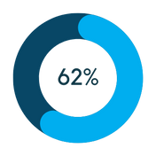


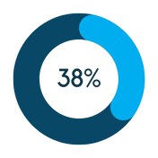


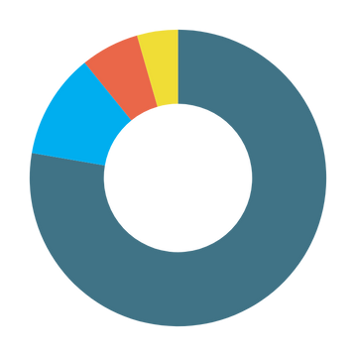





National Tertiary Student Profile
2023 - 2024
Gender
Country of Origin
Ireland
Ukraine
Age
EU Countries
Non EU Countries
72%
Age Under 25
9%
Age 25 - 34
Other
7%
Age 35 - 44
5%
Age 45 - 65
Not reported

Slide 10

Tertiary Degrees 2024-2025
19 Degree Programmes
68% increase in Student Numbers
New HEI partners
New ETB Partners
New Tertiary Degrees are offered in:
Mental Health Nursing
Social Work
Tourism and Hospitality
Public Health
Mobile and Web Computing
+68%

Slide 11


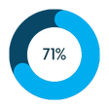
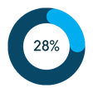

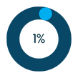

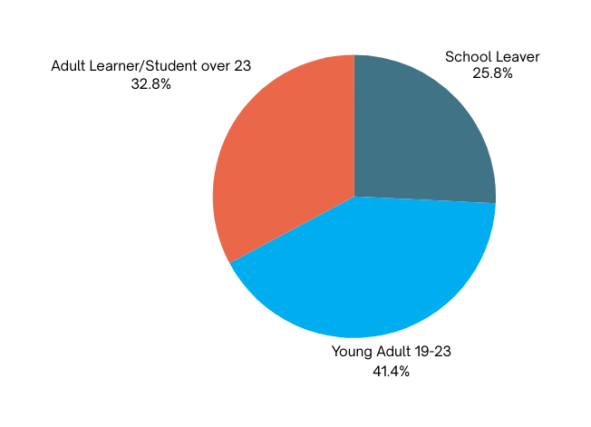



National Tertiary Student Profile
2024 - 2025
Gender
Country of Origin
Female
Male
Non-binary
Ireland
Ukraine
Age
EU Countries
Britan
Other
Not reported

Slide 12
Tertiary Degrees 2025
BSc (Hons) Digital Arts
BA (Hons) Immersive Media Production
BSc (Hons) Software Development
BA (Hons) Digital and Business Skills
BA (Hons) Animation, Visual Effects & Motion Design
BSc (Hons) in Information Technology Management
BSc (Hons) in Mobile & Web Computing
BSc (Hons) in Software Development
BSc in Process Manufacturing Practice & Technology
IT & Technology
Art and Media
BSc (Hons) in General Nursing
BSc (Hons) in Mental Health Nursing
Bachelor of Social Work (Hons)
BSc (Hons) in Occupational Therapy
BSc in Applied Health Care
BSc (Hons) in Public Health and Health Promotion
BSc (Hons) Intellectual Disability Nursing
BA (Hons) Social Care Practice
BBs in Tourism and Hospitality Services
Bachelor in Business (Hons); Bachelor of Business; BB (Hons) in Business
BA (Hons) in Business Studies with Beauty and Spa Management
BSc (Hons) Applied Sports Science
BBs (Hons) Business and Psychology
BA (Hons) Politics, Society and Media
Health
Other
*Availability of all courses is subject to approval and validation

Slide 13
Tertiary Degrees 2026
PRIMARY TEACHER TRAINING TERTIARY PATHWAY
•Opens opportunity to diversify the profession.
•Collaborative development by ETBI and HEIs in partnership with NTO, DoE, DFHERIS and Teaching Council.
•Removing existing structural barriers to access the degree.
•Ensuring that high standard of ITE continue to be deliveed.
HSE TERTIARY PATHWAY – Nursing and wider healthcare
•Working with HSE on supporting resourcing in the priority areas.
•Building pathway for progression with access to employment at different points of a learner journey.
•Assist with addressing retention issues.
OTHER AREAS OF PATHWAY DEVELOPMENT
•Immersive Software Engineering
•Veterinary Nursing
•Sport
•Technical Theatre
•Dance
•Other

Slide 14

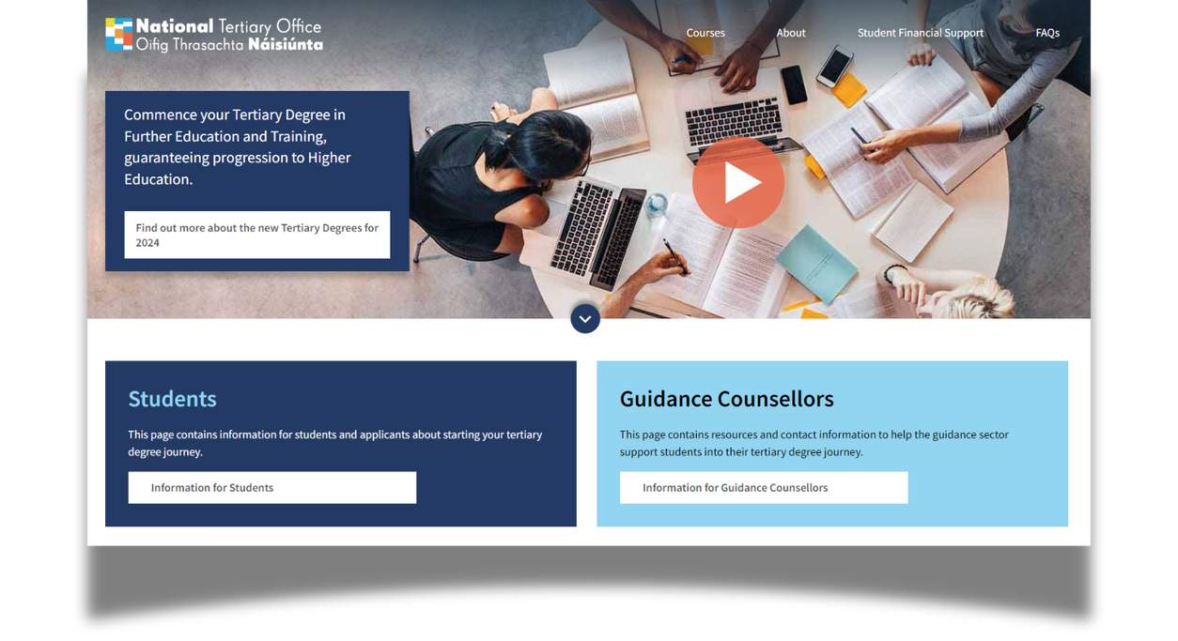
Tertiary Guidance Toolkit
Applications open until Mid September
Closing
date
No tuition or student contribution fees during study years in ETB
Embedded
No limit on
Awards
choices
No fee to apply
Points
No Points
Fees
Local
Dual student card
Smaller class
HEI Bursaries
groups
Dual support and services: libraries, sports, academic, health and wellbeing supports
Higher Education
Accommodation
SUSI grant
https://nto.hea.ie/information-for-guidance-counsellors/
TERTIARY DEGREE
Access to both campuses
TRADITIONAL DEGREE
ROUTE
ROUTE

Slide 15


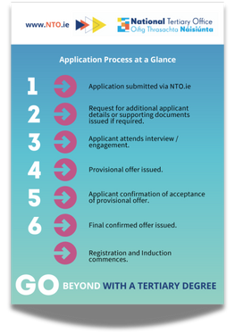

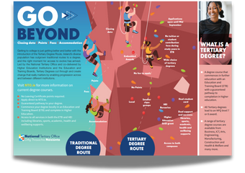


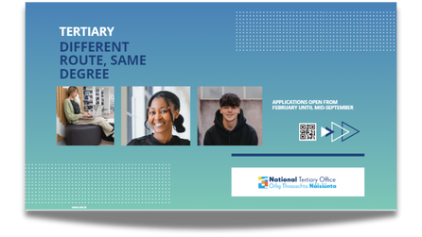
Tertiary Guidance Toolkit
NTO Brochure
Application Timeline
NTO Flier
Applicant Guidelines
Guidance
Presentaiton
Information Video

Slide 16
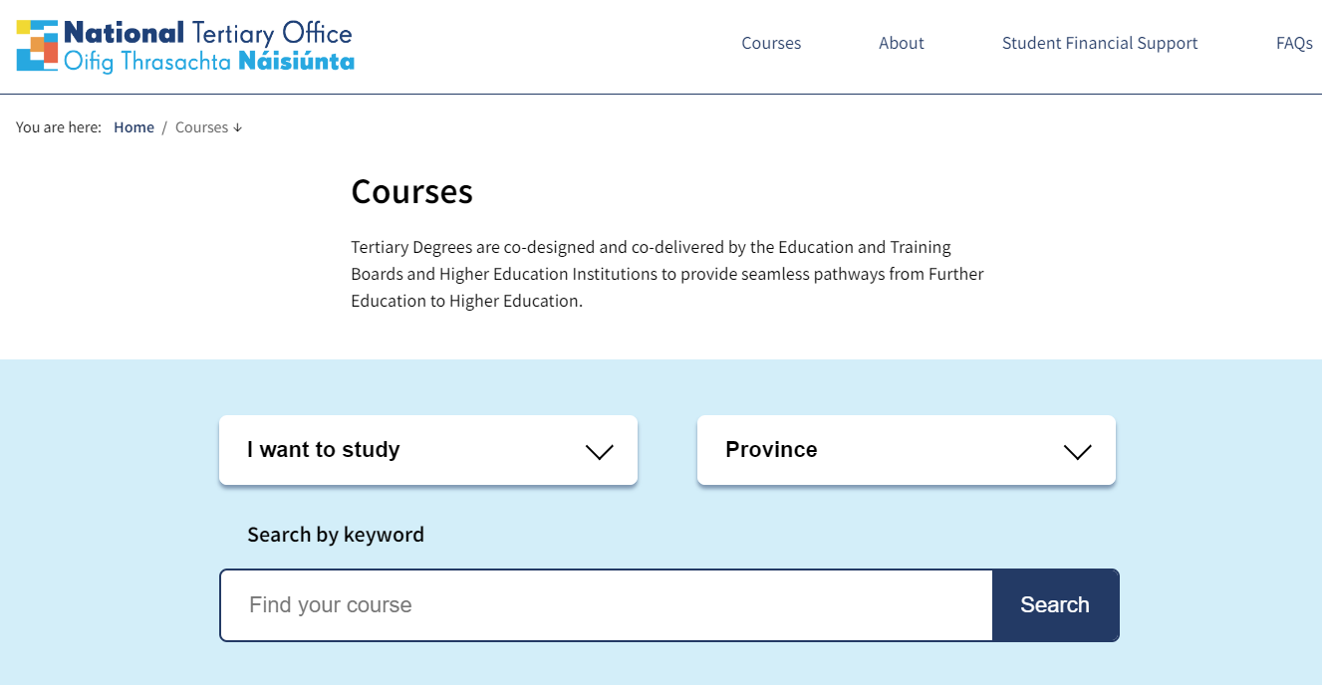

How to Apply:
Courses | National Tertiary Office
Apply

Slide 17

How can NTO help you?
Resources on the NTO.ie
Contact Tertiary Manager in your region
School talks
Talk to IGC branch
Open days in schools
Career fairs
School leadership support
Information webinar

Slide 18









MEET THE NTO
AT
25th of November 2025
Green Isle Hotel, Clondalkin Co. Dublin

Slide 19
Contacts:
eMail: info@nto.ie
Website: www.NTO.ie
LinkedIn: https://www.linkedin.com/in/ntoireland/
Facebook: National Tertiary Office
Instagram: ntoireland

